Slide 1

HEALTHY EATING TIPS

Slide 2
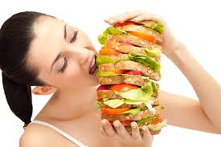
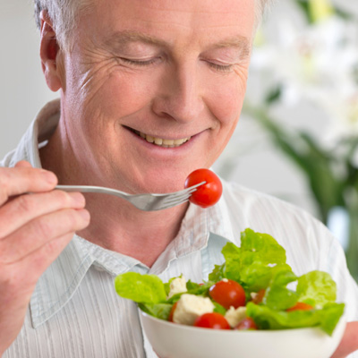
Avoid overeating at a time, instead take small and frequent meals.
Overeating
Small & frequent meals

Slide 3
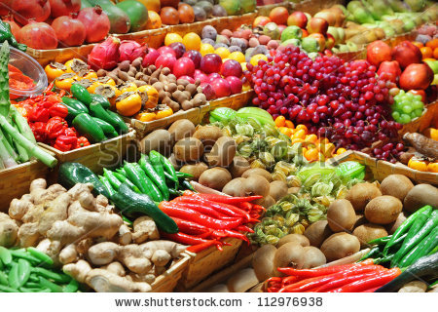
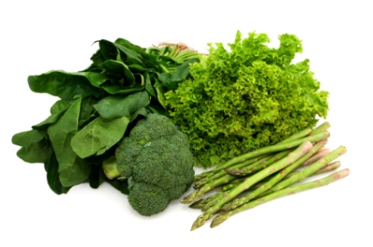
Consume fruits twice a day and green leafy vegetables

Slide 4
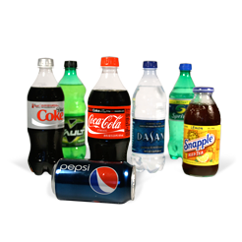
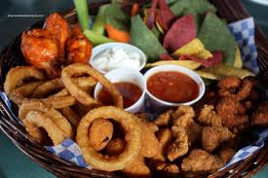
Avoid consumption of carbonated drinks and fried foods

Slide 5
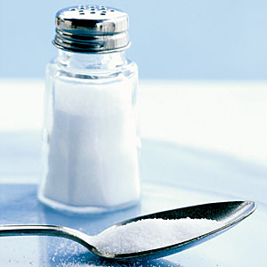
Reduce salt intake
Salt intake should not exceed one teaspoon per day. So avoid consumption of salty foods like papad, pickles, chips, ready made chiwdas and farsan. Avoid salt as it reduces the risk of hyper tension.

Slide 6
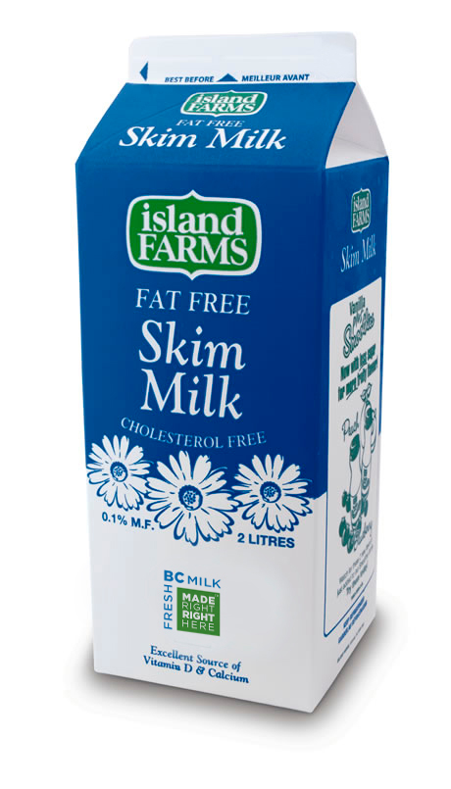
Use skimmed milk
Use low fat or skimmed milk. Cow’s milk is preferable than buffalo’s milk.

Slide 7
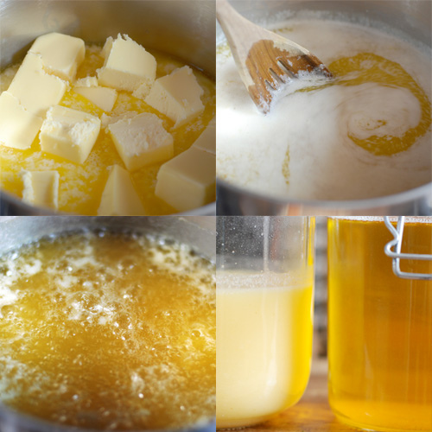
Avoid
The amount of oil should not exceed three to four teaspoons per day and ghee not more than one teaspoon per day.

Slide 8
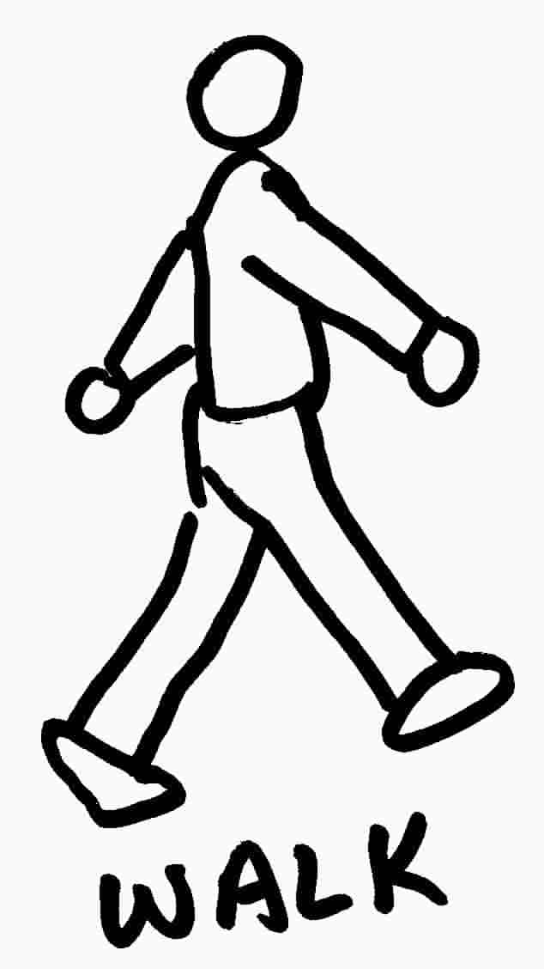
Exercise
Walking for atleast 30 minutes or exercising regularly will reduce the risk of obesity, heart disease and many more. Walking before dinner is suggested.

Slide 9
Myths
Myth:- Getting attracted towards weight loss products.
Reality:- As of date there is no such product which can reduce weight safely and miraculously. There is no such scientific record nor they are practical. One can reduce weight quickly by using such products but quick weight loss is not recommended. A loss of 2 to 3 kgs in a month is advisable.

Slide 10
Myths
Myth:- Taking tea or coffee frequently does not add much to calorie intake compared to fried foods.
Reality:- A calorie is a calorie whether it is coming from any of the food groups. Important is the amount consumed. For e.g. 4 cups of coffee a day (with 100ml toned milk per cup) can contribute 440 calories. Compared to 216 calories coming from 20 pieces of potato chips.

Slide 11
CALORIE CONTENT
FOOD ITEMS | QUANTITY | CALORIES
SOFT DRINKS | 300 ml | 120 to 135
POTATO WAFERS | 50 g | 430
SAMOSA | 40 g | 130
CHEESE PIZZA | 100 g | 240
CHEESE BURGER | 100 g | 290
CAKE | 50 g | 150
CHOCOLATE CAKE | 50 g | 250
PASTRY | 50 g | 250 to 400
CUSTARD | 150 g | 360

Slide 12
CALORIE CONTENT
FOOD ITEMS | QUANTITY | CALORIES
FRUIT SALAD | 150 g | 150
ICE CREAM | 150 g | 300
SHEERA | 60 g | 136
JALEBI | 50 g | 206
GULAB JAMUN | 50 g | 193
SHRIKHAND | 100 g | 206
MILK (BUFFALO) | 45 ml | 50
CURD | 100 g | 50
CHEESE | 15 g | 50

Slide 13
CALORIES BURNT FOR 30 MINUTES
ACTIVITIES | KCAL | ACTIVITIES | KCAL
AEROBICS | 178 | CYCLING | 150
GARDENING | 75-100 | DANCING | 130
JOGGING | 250- 300 | HOUSE WORK | 75 -125
RUNNING | 325 | SKIPING | 252
UPSTAIRS | 300 | DOWNSTAIRS | 210
SWIMMING | 300 | WALKING (4.8 kmph) | 150
DRIVING CAR | 50 | WALKING (5.6kmph) | 180
WATCHING TV | 50 | WALKiNG ( 7.0 kmph) | 200

Slide 14
DISADVANTAGES OF INDIAN DIET
Excess use of fat (for e.g. ghee, butter, oil, etc)
Use of sugar in normal diet (for e.g. adding sugar in dal, vegetables, poha, etc.)
Lack of exercise.
Use of table salt.
Consumption of fried foods.
Inclusion of junk foods in normal diet.
Binge eating ( eating between main meals)

Slide 15
Body Mass Index (BMI)
BMI = weight in kg / height in (m)²
Cut off
Undernourished = less than 18.5
Normal = 18.5 – 22.9
Overweight = 23 – 25
Obese = greater than 25

Slide 16
OBSTACLES IN LOSING WEIGHT
DEPRESSION AND STRESS:
Depression can lead to problems of increased body weight. This is because of the chemical imbalance existing within the brain of the depressed people, that affects the appetite control in the brain.
SOLUTION: Joining a club with physical activity, aerobics can be a good exercise, going for a walk each morning, having a regular therapeutic massage to relieve physical and emotional stresses.

Slide 17
OBSTACLE
LACK OF EXERCISE: Many people following a diet plan fail to maintain a regular exercise pattern. This can be due to busy time schedules, fatigue etc. But such practice should not be employed.
SOLUTION: Regular exercise will increasing the metabolic rate and weight loss and thereby gradually improve the fitness levels.

Slide 18
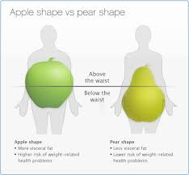
APPLE
VS
PEAR

Slide 19
‘APPLE SHAPED’
APPLE SHAPED ( ANDROID) : Is characterised by fat distributed in the upper body above the waist.
The characteristics of android body type includes broad shoulders, strong muscular arms and legs, a narrow pelvis and narrow hips. There are increased risk of coronary heart diseases. A high degree of accumulation of adipose tissue is associated with glucose intolerance and hyperinsulinemia resulting from insulin resistance.

Slide 20
‘PEAR SHAPED’
PEAR SHAPED (GYNOID ): It is characterized by the fat deposition in the lower body that is lower abdomen, buttocks, hips and thighs. Generally seen in females. The characteristics of this body type is small to medium shoulders, a narrow tapering waistline and wide hips. Weight gain tends to occur on thighs and buttocks. Found in premenopausal women is not a major threat to cardiovascular health.

Slide 21
R.D.A for children from 4- 6 years
The body weight of the child should be between 18 to 20 kgs
The calorie intake for a 4-6 year old child should be 1350 to 1500 kcal per day.
Protein content of their diet should be 20.1 to 22 g per day.
Fat in the diet should be 25 g per day.

Slide 22
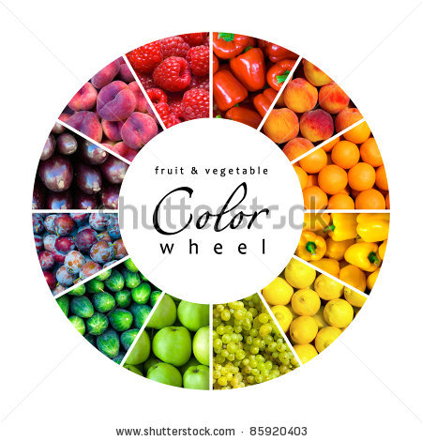
Consume all colors of fruits and vegetables everyday.

Slide 23
PRESENTED BY:
RICHA .S. SHAH
FROM: MS UNIVERSITY AS A DIETICIAN.

